Slide 1
Lecture 6 3D Modeling and Animation Assoc.Prof.Dr. Hossam Mahmoud Moftah Associate professor – Faculty of computers and artificial intelligence– Beni-Suef University

Slide 2
Chapter 4 Exploring Animation, Story, and Pre-visualization
Adapted from Andy Beane: 3D animation essentials 2012 by John Wiley & Sons, Inc.,

Slide 3
Using Pre-visualization Techniques
Camera Movements
Camera movements definition : indicate how the camera can be moved.
Cameras movements ways:
Pan
Tilt
Roll
Dolly
Track
Pedestal
Zoom
Handheld
Rack Focus
Adapted from Andy Beane: 3D animation essentials 2012 by John Wiley & Sons, Inc.,

Slide 4
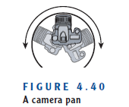
Using Pre-visualization Techniques
Cameras movements ways:
Pan:
Pan definition: A pan (Figure 4.40) is a rotation of the camera side to side, horizontally. This move can be created by hand or by rotating the camera on a tripod.
Adapted from Andy Beane: 3D animation essentials 2012 by John Wiley & Sons, Inc.,

Slide 5
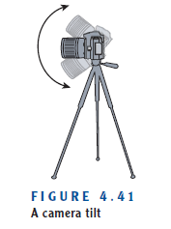
Using Pre-visualization Techniques
Cameras movements ways:
2. Tilt:
Tilt definition: tilt (Figure 4.41) is a rotation of the camera up or down, vertically. This move can be created by hand or by rotating the camera on a tripod.
Adapted from Andy Beane: 3D animation essentials 2012 by John Wiley & Sons, Inc.,

Slide 6
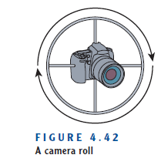
Using Pre-visualization Techniques
Cameras movements ways:
3. Roll :
Roll definition: This involves rotating the camera on its side or upside down. This kindof camera rotation will allow the camera to roll 360 degrees if needed for effect. (See Figure 4.42.)
Adapted from Andy Beane: 3D animation essentials 2012 by John Wiley & Sons, Inc.,

Slide 7
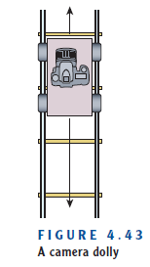
Using Pre-visualization Techniques
Cameras movements ways:
4. dolly :
dolly definition: A dolly (Figure 4.43) can move the camera forward or backward, toward or away from the subject.
Adapted from Andy Beane: 3D animation essentials 2012 by John Wiley & Sons, Inc.,

Slide 8
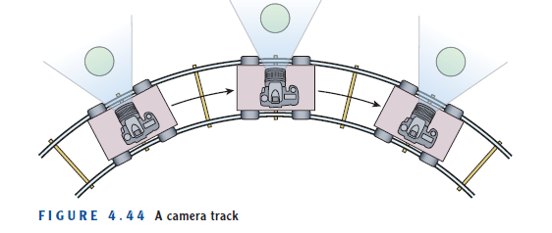
Using Pre-visualization Techniques
Cameras movements ways:
5. Track :
Track definition: You can move the camera along a track to follow the subject, typically from side to side (Figure 4.44). This is not to be confused with a dolly, which moves forward and backward.
Adapted from Andy Beane: 3D animation essentials 2012 by John Wiley & Sons, Inc.,

Slide 9
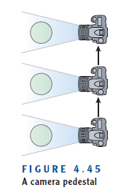
Using Pre-visualization Techniques
Cameras movements ways:
6. Pedestal :
Pedestal definition: A pedestal (Figure 4.45) tracks the height of an object by moving the camera vertically.
Adapted from Andy Beane: 3D animation essentials 2012 by John Wiley & Sons, Inc.,

Slide 10
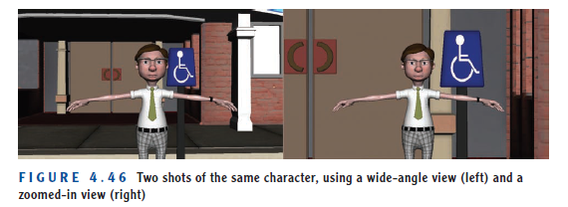
Using Pre-visualization Techniques
Cameras movements ways:
7. Zoom :
Zoom definition: A zoom is different from the other camera moves because you are not physically moving the camera, but rather moving the lens to create movement in the frame.
Adapted from Andy Beane: 3D animation essentials 2012 by John Wiley & Sons, Inc.,

Slide 11
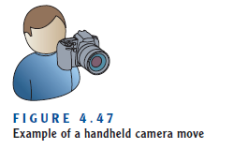
Using Pre-visualization Techniques
Cameras movements ways:
8. Handheld :
Handheld definition: A handheld movement (Figure 4.47) entails holding the camera and moving freely in any direction to follow the action.
Adapted from Andy Beane: 3D animation essentials 2012 by John Wiley & Sons, Inc.,

Slide 12
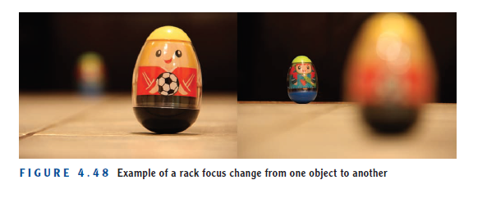
Using Pre-visualization Techniques
Cameras movements ways:
9. Rack Focus:
Rack Focus definition: This involves changing the focus of the camera to push an object that is out of focus into focus, or vice versa.
Cameras movements
Adapted from Andy Beane: 3D animation essentials 2012 by John Wiley & Sons, Inc.,

Slide 13
Using Pre-visualization Techniques
Editing:
Editing definition: is the stage where the story really comes together.
The guidelines for the editing process:
Cuts
180-Degree Rule
Adapted from Andy Beane: 3D animation essentials 2012 by John Wiley & Sons, Inc.,

Slide 14
Using Pre-visualization Techniques
Editing:
Cuts
Cuts definition: A cut is an abrupt change in the imagery that provides the transition to a new shot.
basic types of cuts:
Thoughtful Cuts
Cut on a Look
Jump Cuts
Transitions
Adapted from Andy Beane: 3D animation essentials 2012 by John Wiley & Sons, Inc.,

Slide 15
Using Pre-visualization Techniques
Editing:
Thoughtful Cuts
Thoughtful Cuts definition: Never make a cut without a reason.
That reason can be simple: something gets in the way of the action, or the actors just stopped being in character because they are being distracted by something offscreen or laughing at another actor, for example.
Adapted from Andy Beane: 3D animation essentials 2012 by John Wiley & Sons, Inc.,

Slide 16
Using Pre-visualization Techniques
Editing:
Cut on a Look
Cut on a Look definition: It is difficult to the viewer to cut from a shot with movement to a shot that has no movement in it. (For that reason, this type of cut is known as a cut in movement.).
Adapted from Andy Beane: 3D animation essentials 2012 by John Wiley & Sons, Inc.,

Slide 17
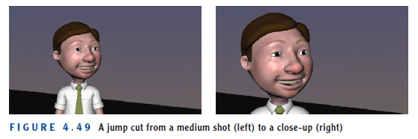
Using Pre-visualization Techniques
Editing:
Jump Cuts
Jump Cuts definition: Avoid jump cuts! A jump cut is one that changes from one shot to another that has the same composition.
For instance, if you start with a medium shot of a character centered in the frame and cut to another medium shot of a character centered in the frame, that is a jump cut.
Adapted from Andy Beane: 3D animation essentials 2012 by John Wiley & Sons, Inc.,

Slide 18
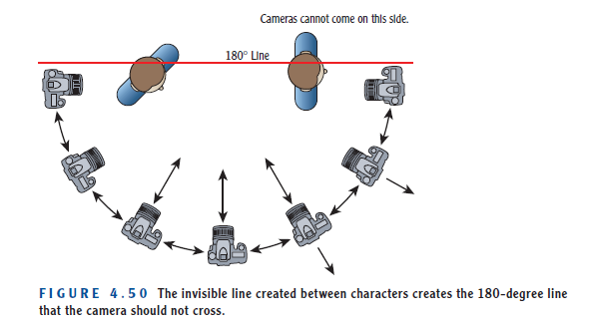
Using Pre-visualization Techniques
Editing:
180-Degree Rule
180-Degree Rule definition: The 180-degree rule states that two characters should have the same left and right space onscreen in a sequence.
Adapted from Andy Beane: 3D animation essentials 2012 by John Wiley & Sons, Inc.,

Slide 19
Chapter 5 Understanding Modeling and
Texturing
Adapted from Andy Beane: 3D animation essentials 2012 by John Wiley & Sons, Inc.,

Slide 20
Modeling and Texturing
Modeling is the act of creating a 3D object.
Texturing is applying the color and surface properties to the model.
Modeling and texturing are two of the primary jobs within the field of 3D animation and are closely tied to one another.
Adapted from Andy Beane: 3D animation essentials 2012 by John Wiley & Sons, Inc.,

Slide 21
Modeling
Modeler is the job title of an artist who creates or cleans up the geometry of a 3D model.
A modeler can use three geometry types to create models:
polygons,
non uniform rational B-splines (NURBS),
subdivision surfaces.
Adapted from Andy Beane: 3D animation essentials 2012 by John Wiley & Sons, Inc.,

Slide 22
Modeling
polygons
polygons definition: Polygons are made up of three or more corners known as vertices (a single one is called a vertex) and the lines connecting those vertices, called edges.
Polygons are the geometry type most widely used by 3D modelers today.
Polygons forms:
tri.
Quad
n-gon, or n-sided polygon
Adapted from Andy Beane: 3D animation essentials 2012 by John Wiley & Sons, Inc.,

Slide 23
Modeling
Polygons forms:
Tri:
The most basic form of polygon is a three-sided one called a tri.
Quad :
The most used type of polygon is a four-sided one known as a quad.
n-gon, or n-sided polygon:
Most 3D modelers avoid using an n-gon, or n-sided polygon, which is a polygon with five or more sides.
Adapted from Andy Beane: 3D animation essentials 2012 by John Wiley & Sons, Inc.,

Slide 24
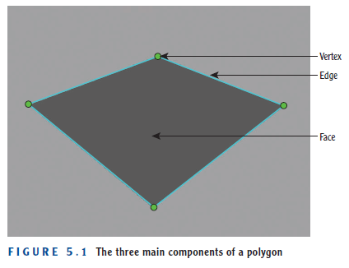
Modeling
Polygon components :
vertex,
edge,
face
Adapted from Andy Beane: 3D animation essentials 2012 by John Wiley & Sons, Inc.,

Slide 25
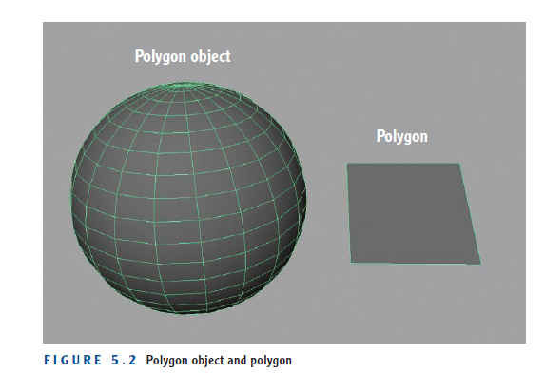
Modeling
Polygon objects and polygon meshes
Collections of polygons make up a polygon object or polygon mesh, creating a shape such as a sphere (see Figure 5.2).
Adapted from Andy Beane: 3D animation essentials 2012 by John Wiley & Sons, Inc.,

Slide 26
Modeling
Operations on polygons:
dividing,
smoothing,
extruding,
beveling,
deleting,
combining,
separating.
Adapted from Andy Beane: 3D animation essentials 2012 by John Wiley & Sons, Inc.,

Slide 27
Modeling
Operations on polygons:
dividing,
When dividing a polygon, you create a new edge across its face, as shown in Figure 5.3.
Dividing can happen across a single polygon or around an entire polygon object.
Dividing an entire polygon object is often referred to as adding an edge loop
Adapted from Andy Beane: 3D animation essentials 2012 by John Wiley & Sons, Inc.,

Slide 28
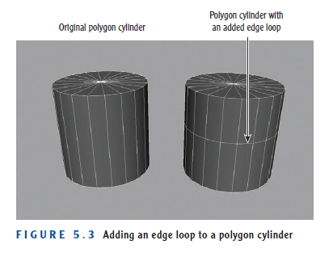
Modeling
dividing,
Adapted from Andy Beane: 3D animation essentials 2012 by John Wiley & Sons, Inc.,

Slide 29
Modeling
Operations on polygons:
dividing,
The way edges flow along a model is called edge flow.
Good edge flow is organized and typically follows the shape of the object or the muscle anatomy of a creature.
Adapted from Andy Beane: 3D animation essentials 2012 by John Wiley & Sons, Inc.,

Slide 30
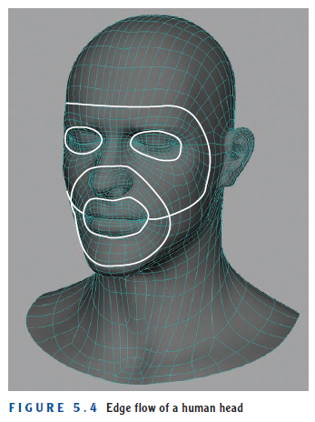
Modeling
dividing,
dividing
Adapted from Andy Beane: 3D animation essentials 2012 by John Wiley & Sons, Inc.,

Slide 31
Modeling
Operations on polygons:
2. Smoothing,
Smoothing subdivides a polygon object and averages the angles formed by all edges of the original geometry.
The left image in Figure 5.5 shows a cube that has been smoothed twice, subdividing its faces and changing the cube into a sphere.
Adapted from Andy Beane: 3D animation essentials 2012 by John Wiley & Sons, Inc.,

Slide 32
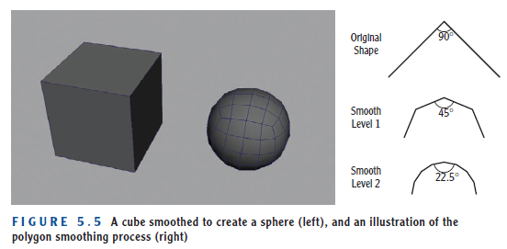
Modeling
2. Smoothing
Adapted from Andy Beane: 3D animation essentials 2012 by John Wiley & Sons, Inc.,

Slide 33
Modeling
Operations on polygons:
3. Extruding,
Extruding adds geometry to a polygon surface by creating a new surface, offsetting that new surface, and then creating more new surfaces between the offset and original surface.
Figure 5.6 shows an example of extruding.
Adapted from Andy Beane: 3D animation essentials 2012 by John Wiley & Sons, Inc.,

Slide 34
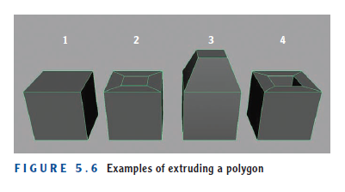
Modeling
Operations on polygons:
3. Extruding,
C ube 1 is the original polygon object. In cube 2, the top face has been extruded and scaled inward. In cube 3, the extrusion is moved up. In cube 4, the top face has been extruded and scaled inward, and then the inner face of that extrusion has been extruded again and moved down to make a hole in the top of the cube.
Adapted from Andy Beane: 3D animation essentials 2012 by John Wiley & Sons, Inc.,

Slide 35
Modeling
Operations on polygons:
4. Beveling,
Beveling adds a face or faces that are not perpendicular to the original faces connected by the edges of a polygon model, to give them a slightly rounded shape.
Figure 5.7 shows close-up and zoomedout views of two cubes rendered in 3D.
Adapted from Andy Beane: 3D animation essentials 2012 by John Wiley & Sons, Inc.,

Slide 36
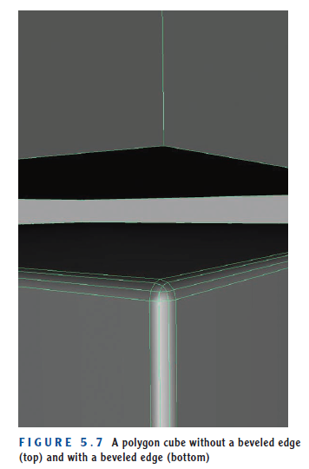
Modeling
Operations on polygons:
4. Beveling,
Adapted from Andy Beane: 3D animation essentials 2012 by John Wiley & Sons, Inc.,

Slide 37
Modeling
Operations on polygons:
5. Deleting, 6. Combining, and 7.Separating,
Deleting, combining, and separating all contribute to making the polygon such an easy type of geometry to use.
Adapted from Andy Beane: 3D animation essentials 2012 by John Wiley & Sons, Inc.,

Slide 38
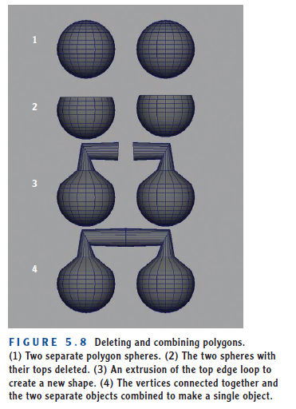
Modeling
Operations on polygons:
5. Deleting, 6. Combining, and 7.Separating,
Adapted from Andy Beane: 3D animation essentials 2012 by John Wiley & Sons, Inc.,

Slide 39
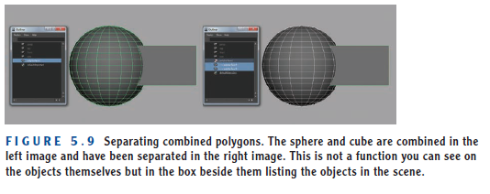
Modeling
Operations on polygons:
5. Deleting, 6. Combining, and 7.Separating,
Adapted from Andy Beane: 3D animation essentials 2012 by John Wiley & Sons, Inc.,

Slide 40
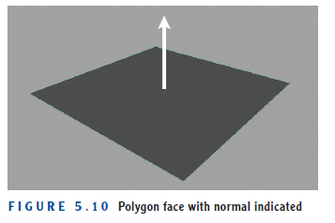
Modeling
Shading of a polygon
Shading is created by the normals of a polygon surface.
A normal is a vector line that points perpendicularly straight out of the surface, as shown in Figure 5.10.
Adapted from Andy Beane: 3D animation essentials 2012 by John Wiley & Sons, Inc.,

Slide 41
Modeling
Shading of a polygon
The 3D software uses these normals to assign each polygon face its front and back side.
The vector is drawn in both directions from the face, and the math algorithm that creates the face via the user’s commands differentiates the front from the back side.
many 3D software packages will not render the back side of a polygon unless instructed to by the user.
Adapted from Andy Beane: 3D animation essentials 2012 by John Wiley & Sons, Inc.,

Slide 42
Modeling
Shading of a polygon
Figure 5.11 shows a polygon sphere.
On the left side of the image, a few normals have been reversed (highlighted).
The right side of the image shows the faces that have inverted normals as black, because the render engine by default ignores the faces that are not facing the camera.
Adapted from Andy Beane: 3D animation essentials 2012 by John Wiley & Sons, Inc.,

Slide 43
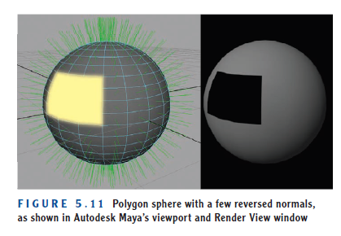
Modeling
Shading of a polygon
Adapted from Andy Beane: 3D animation essentials 2012 by John Wiley & Sons, Inc.,

Slide 44
The End

